Slide 1

Safeguarding Overview for
Businesses

Slide 2
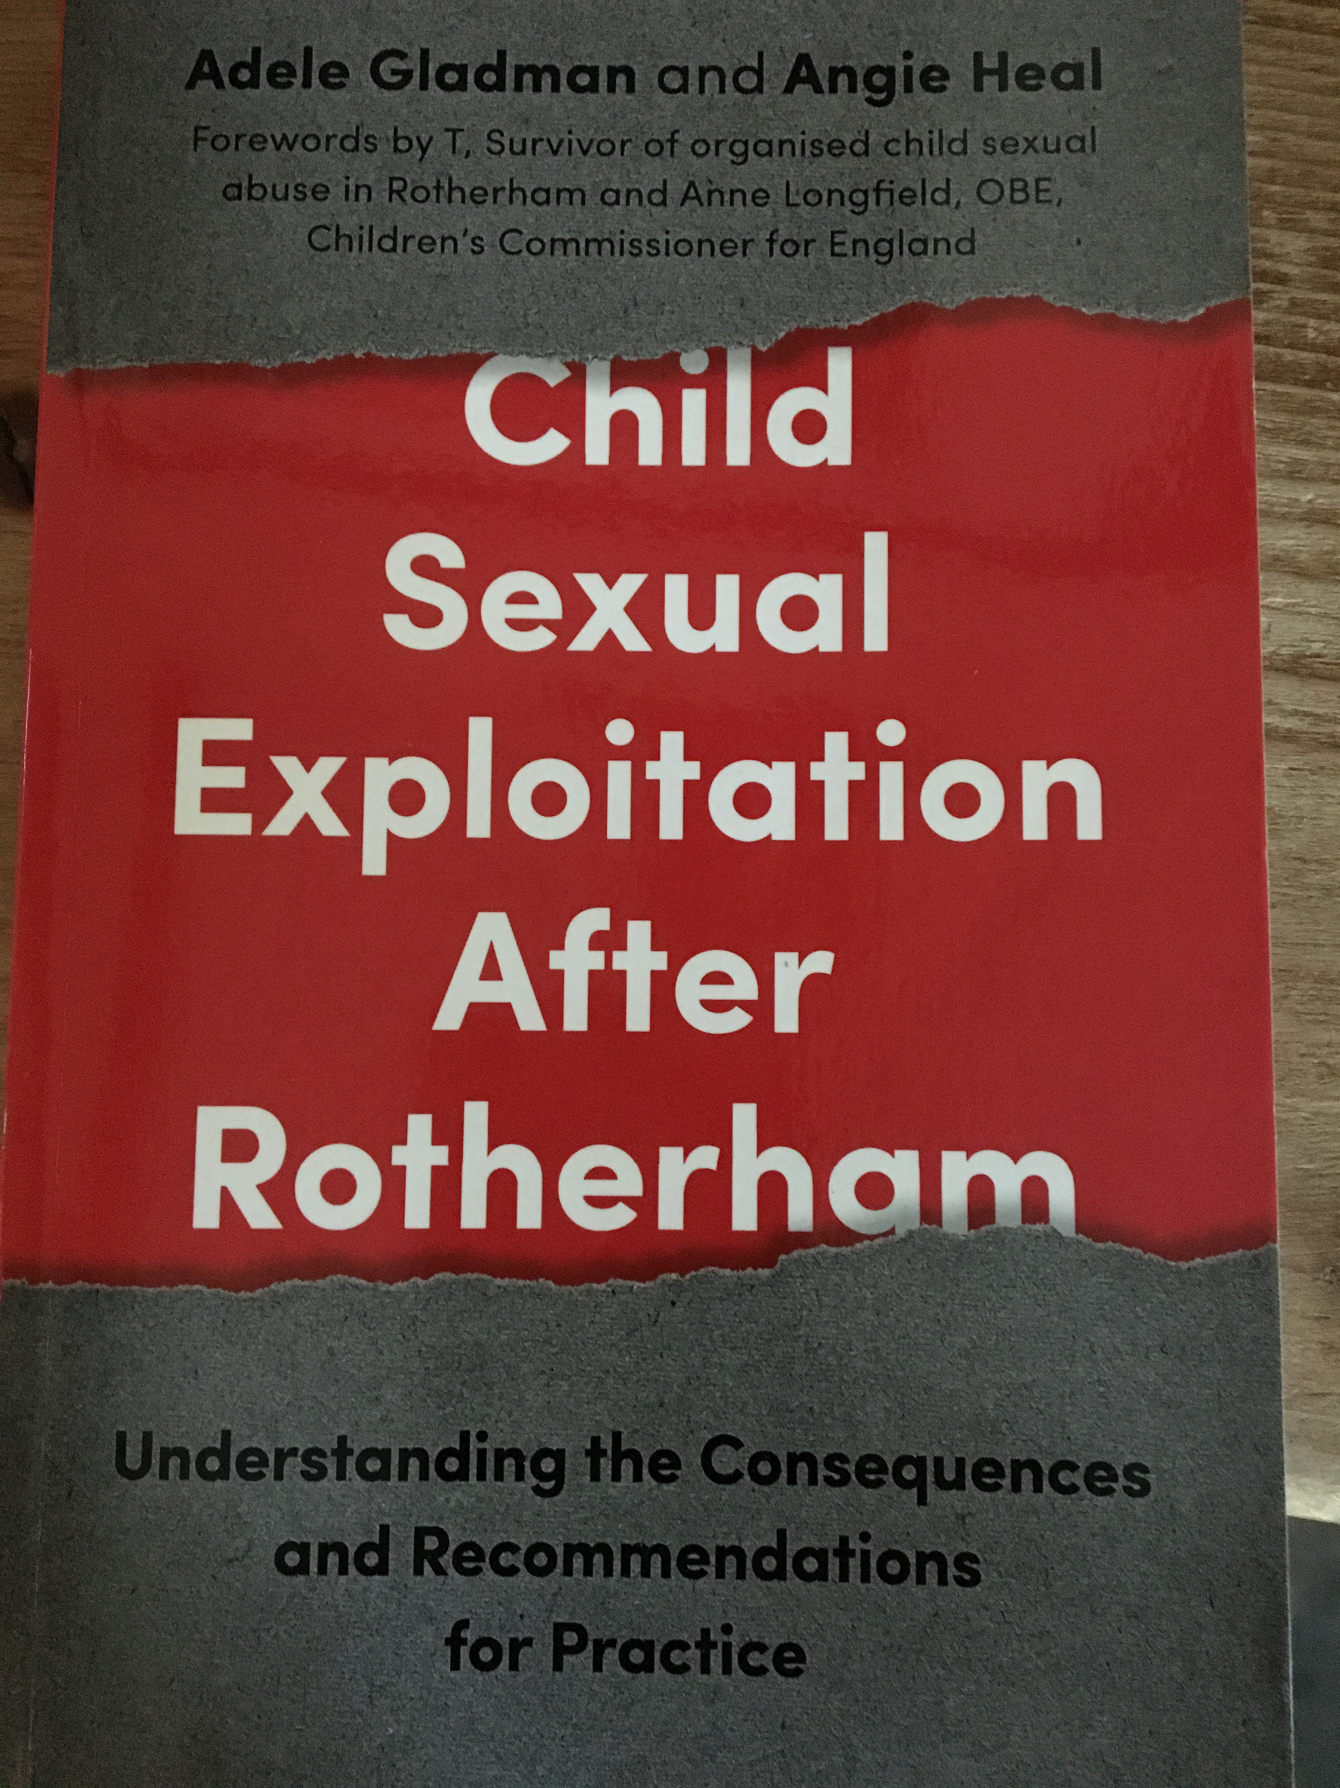
Who am I?
Former solicitor. From 2000-2002 Research and Development Officer employed to lead the Home Office funded pilot in Rotherham
Independent safeguarding trainer and consultant across the UK since 2002
Author, NSPCC Associate, Consultant to Home Office, Foreign Office, APSCO
Independent safeguarding work nationally. Involved with and contributed to other national initiatives and inquiries (such as IICSA)
Auditor for APSCo and accredited Safer Recruitment Trainer NSPCC
Work with services across the UK and internationally including commercial organisations such as Merlin Entertainments
Safeguarding Trustee for local SARC & Safeguarding Governor for national apprenticeship provider

Slide 3
How I can support your business
I support a range of businesses with the following:
  Policies, processes, structures, and systems
  Getting to grips with safeguarding, including workplace audits
  Training courses (face to face, remote)
  Consultancy including advice and independent investigations
  Anything else that you need to pick my brain about!

Slide 4
What is this presentation going to cover?
What is safeguarding?
Where businesses fit in
Safeguarding in practice –what should that look like?
Finding the right approach for your company
Time for questions

Slide 5
Some words of reassurance…
Safeguarding does not have to be scary or complicated!
There are some initial straightforward processes that can be put into place
Advice and resources are available
No-one expects a person or an organisation to know everything
Good practice is beneficial for your organisation and is an advantage for business promotion

Slide 6
Why do you need to think about safeguarding?
Legal obligations for children (under 18) and some young adults (for example, those considered vulnerable or ‘looked after’)
Stakeholder requirements
Insurance terms and conditions
Best practice for your business
Protects employees and apprentices
Brand insurance – reputational damage

Slide 7
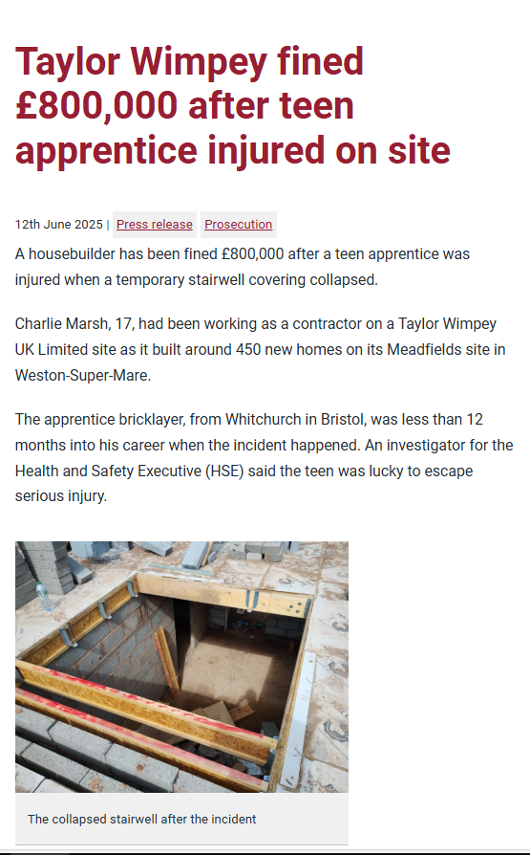
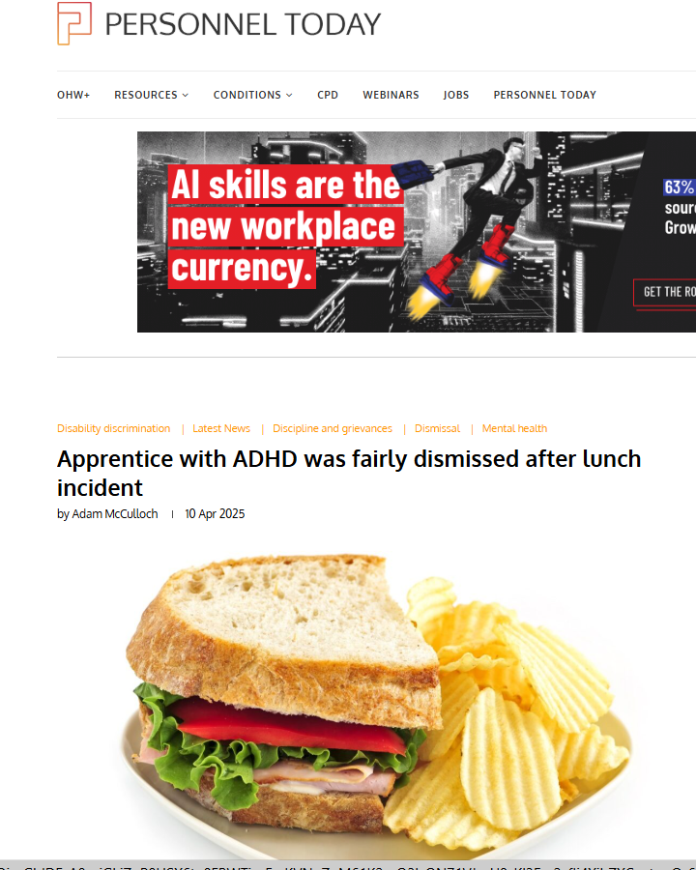
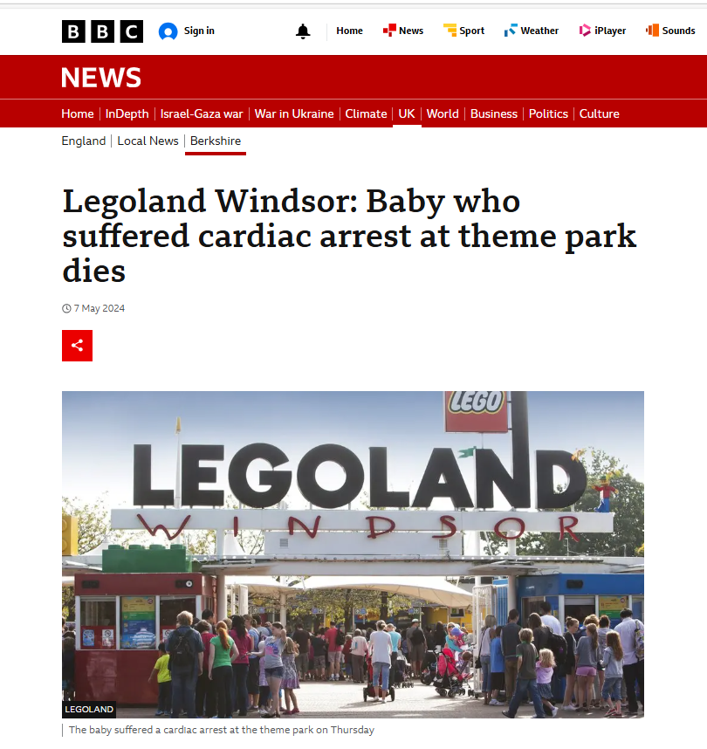
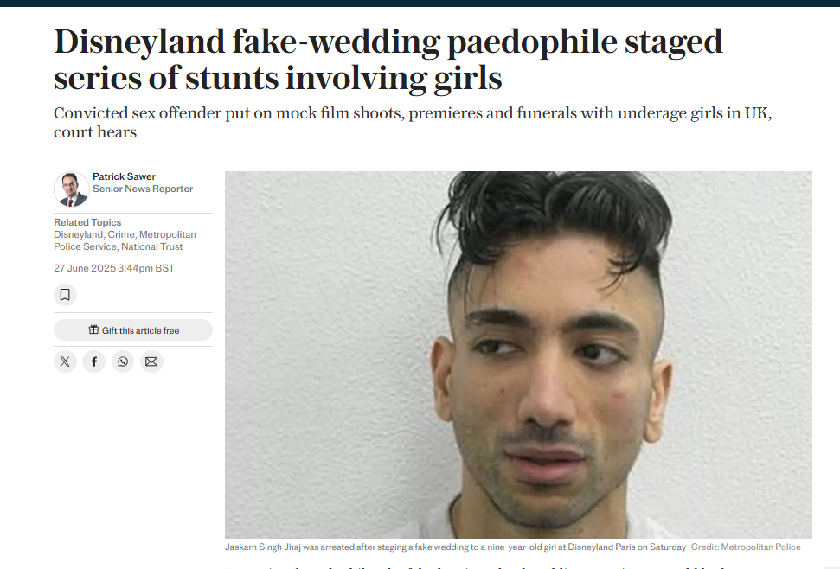
Some examples from the news

Slide 8
Safeguarding can involve…
Identifying concerns and sharing information (this could be regarding an apprentice, visitor, member of staff, member of the public, or another professional)
Acting to prevent harm or a crime being committed – this could involve outside agencies such as the police
Identifying places/people who may be a risk to the vulnerable
Recruiting safely, having an appropriate workplace culture, and giving the workforce the necessary skills to work safely
Supporting staff
Agreements with third parties

Slide 9
When considering safeguarding, there is a duty of care owed to:
Staff (and potentially their families)
Apprentices (and potentially their families)
Visitors (and potentially their families)
Other people who benefit from or come into contact with your organisation through its work (and potentially their families)
“Safeguarding is everyone’s responsibility”

Slide 10

Safeguarding in 2025
Child on child abuse and bullying
Online risks and abuse
Contextual safeguarding such as county lines, and child sexual exploitation
Substance misuse (parents and children)
Children living away from home or ‘sofa surfing’- significant increase since 2021
Mental health and self-harm/suicidal ideation
Child poverty
Radicalisation
Increase in complaints and allegations in the workplace

Slide 11


Slide 12
Case Scenario 1
An event is underway which your organisation has been involved in organising and hosting. One of the attendees is a young person who is aggressive and hostile to female staff and other female attendees. You have heard him make derogatory comments to other males on the event, as well as heard that he is taking photos of different people using a filter which others are laughing at. You have observed him doing this and also note that he has signs of self-harm on his arms.
What are your concerns?
Is it your responsibility to take any action and if so, what?

Slide 13
Case Scenario 2
An employee has been with you for 6 months. They are doing well. The only concern is that you hear from other employees that they often voice views which could be considered racist and often show others social media posts about migrants.
Today you discover that they are planning to take part in a protest outside a local hotel which is housing asylum seekers.
What are your concerns?
Is it your responsibility to take any action and if so, what?

Slide 14
Case Scenario 3
You are responsible for a young apprentice who has poor personal hygiene and discoloured teeth. They often appear at work late, and unkempt. They do not appear to have any social skills. You have noticed that they appear to have poor eyesight. Both staff and clients are complaining. You have received complaints from staff that the young person is asking for money, and food, and you have heard stories of them going into the bin after lunchtime to get out food that someone has thrown away. You know that they have younger siblings at home.
What are your concerns?
Is it your responsibility to take any action and if so, what?

Slide 15
Case Scenario 4
A member of staff has spoken to you in confidence about another staff member. They say that a number of people in your organisation are uncomfortable around them as they have poor boundaries, often making sexualised comments and jokes. Some staff actively avoid being alone with them. The staff member tells you that this person often targets young workers; either bullying and making fun of the males and flirting with the females. They say that several people have left or called in sick as a result of this.
What are your concerns?
Is it your responsibility to take any action and if so, what?

Slide 16
When working with safeguarding issues, you should consider…
Everything from
  Staff recruitment and training
  Setting expectations and boundaries
  Workplace culture and conduct including whistleblowing
  Relevant policies and case management systems
  Staff knowledge and application of policies
  Arrangements with third parties such as colleges
  Apprenticeship/staff feedback especially exit interviews
  Event planning and risk assessments

Slide 17
All staff have a responsibility to:
  Provide a safe environment including considerations for children and young adults who are apprentices
  Attend safeguarding training and be aware of what action to take if they have concerns about a child, adult, member of staff or another professional
  Follow systems within their setting (including safeguarding policy, code of conduct)
  Be part of a process that identifies those who are a risk or intend harm
  Whistleblow when they have concerns about practice (internally or externally)

Slide 18
What everyone in your business needs to know as a minimum
How to identify any concern
What their role is in safeguarding
Where to go to for advice
Where and how to report any concerns (internally or externally)
Know what to expect and when to step away and let others investigate concerns
How to access support and raise concerns about poor practice

Slide 19
10 steps to success in safeguarding
Safer recruitment and safe workplace practice
‘Whole team’ approach
Ensuring that good quality policies (including Code of Conduct) are in place and that staff are appropriately skilled
Know your apprentices/staff and customers!
Support staff in raising concerns
Review cases to consider how risks are being managed, or incidents responded to
Audits/analysis to identify common themes, risks and areas for improvement
Get support when you need it
Partnership working and arrangements
Keep updated

Slide 20
And remember…
This is about you being prepared and confident
This advice is based on years of experience of supporting businesses like yours
You may encounter safeguarding regularly (or not at all)
The key to good safeguarding practice is preparation, consultation, and review
Safeguarding can seem intimidating and complex so seek help and support when you need it!
Being prepared is a good start to feeling confident that you have done the best that you can and defending your business
Support staff involved in safeguarding (especially if it is new to them). We are all human and safeguarding is (and should feel) uncomfortable (but we shouldn’t take it home with us)

Slide 21

Any questions?
Notes:
This gives a chance to check out key learning from this part of the course, check that all participants are not adversely impact and check if there is any uncertainty or any issues for clarification. Participants will also be invited to message in any thoughts, points or questions at the end of the event.

Slide 22



Thank you and keep in touch
  Safeguarding@AdeleGladman
Adele Gladman
adele@protectingchildrennow.co.uk

